Slide 1
An Introduction to Chinese Love Poetry
William R. Long, M Div, PhD, JD

Slide 2
Plan for our time together:
Introduction
Chinese Love Poetry – in Salem, Oregon!
Categories of Love Poetry
Examining the Poems

Slide 3
Introductory Remarks
Bill Long and Eurydice Chen

Slide 4
Chinese Love Poetry – In Salem, Oregon!
The Project
Classical
Broadly representative
Accessible

Slide 5
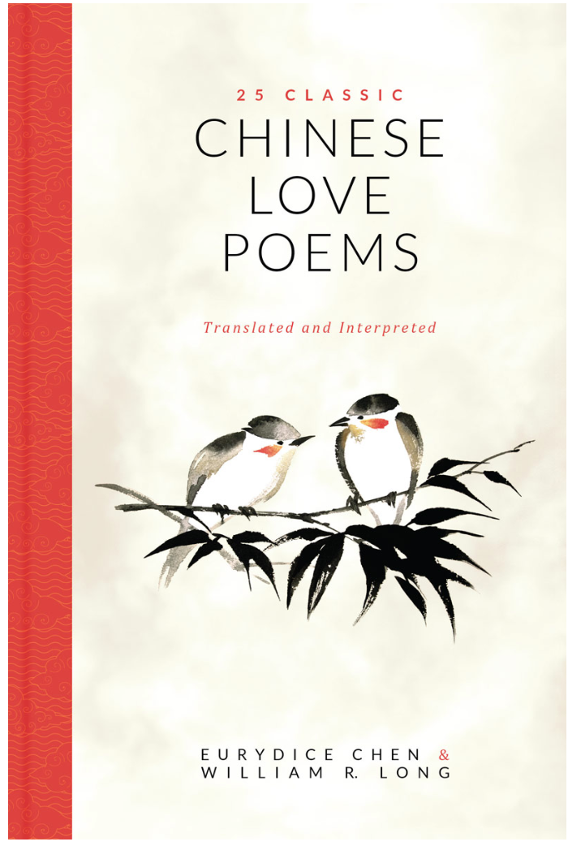
Chinese Love Poetry – In Salem, Oregon!
The Product — book
In this book we invite you into the immense and alluring world of Chinese love poetry.
Our special interest is in poems that describe the full range of the experience of love, from wooing the beloved…to losing a partner much too early.
We hope you enjoy these poems as much as we do.

Slide 6
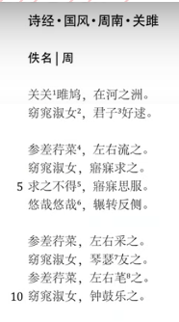
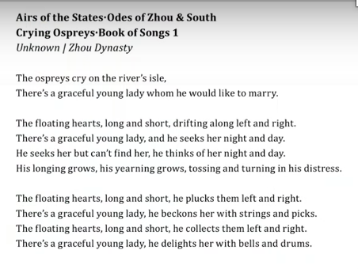
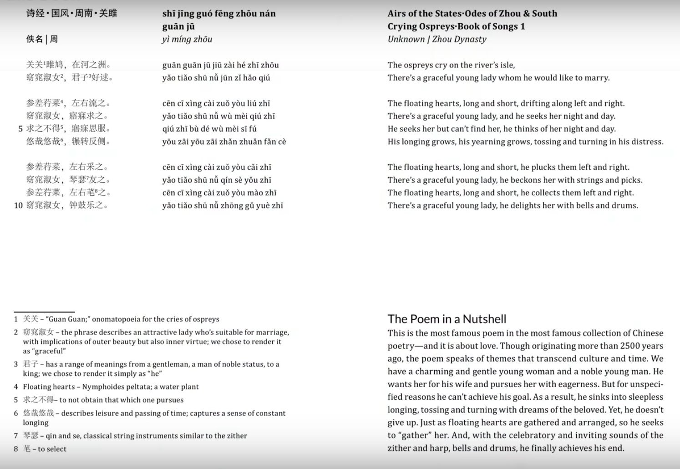
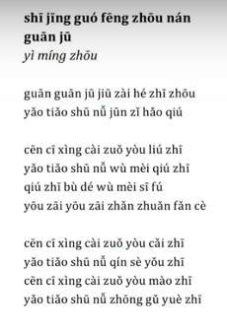
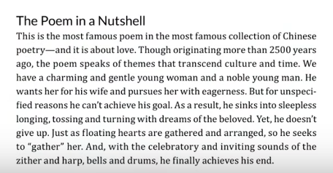
The Chinese version
The Pronunciation
The English version
Footnotes
The Poem in a Nutshell

Slide 7
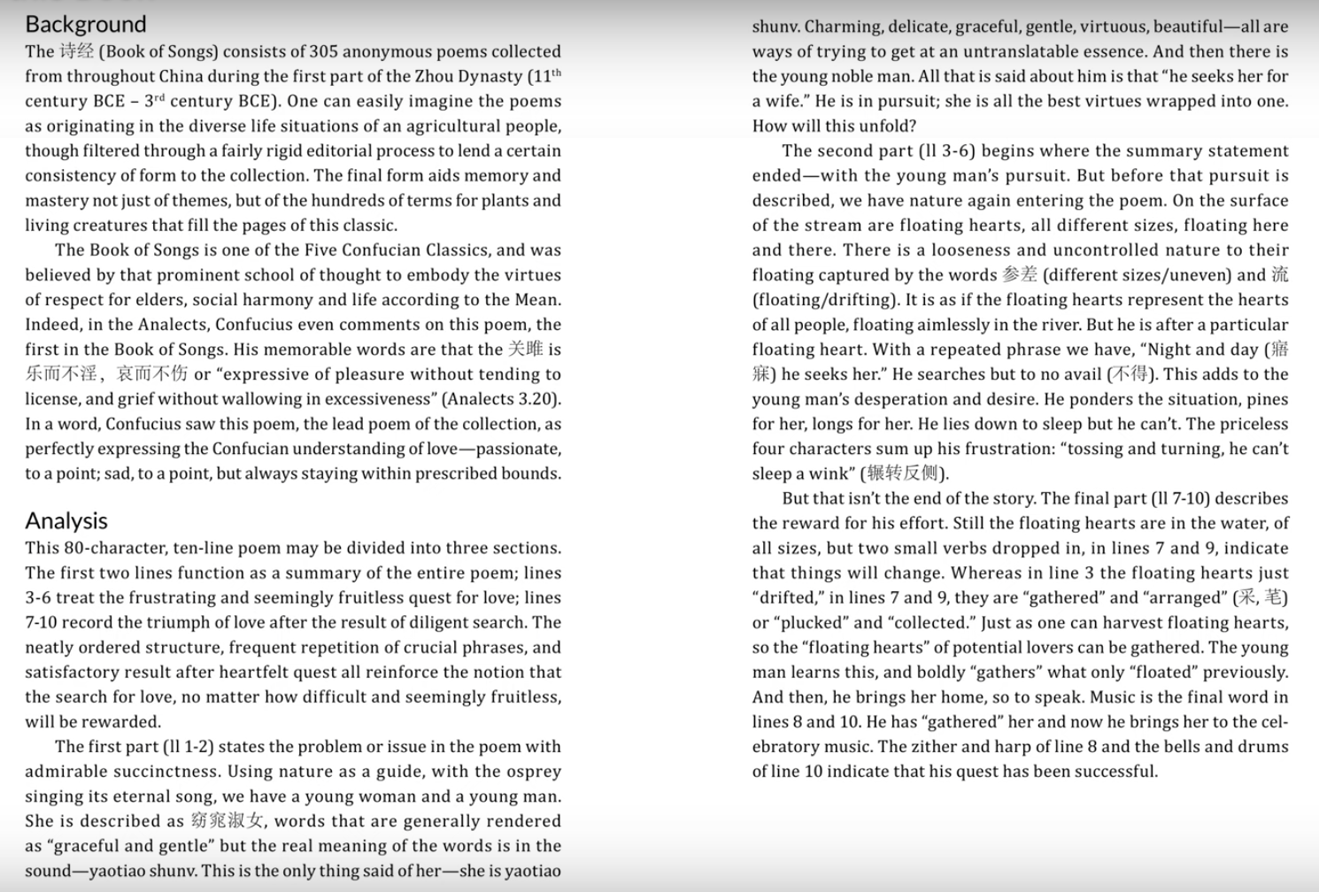
Background
Analysis

Slide 8
The Project
The Chinese Version
The Pronunciation
English Translation
Footnotes
The Poem in a Nutshell
The Background
The Analysis
video

Slide 9
Categories of Love Poetry
Wooing or Courting
The Classic of Poetry 1
Remembering Absent Lovers
Wang Wei (699-758), Tang Dynasty
Li Qingzhao (1084-1150), Song Dynasty
The Devastating Experience of Loss – Ten Years Later
Su Shi (1036-1101), Song Dynasty

Slide 10
Wooing or Courting

Slide 11
关关雎鸠，在河之洲。
窈窕淑女，君子好逑。
参差荇菜，左右流之。
窈窕淑女，寤寐求之。
求之不得，寤寐思服。
悠哉悠哉，辗转反侧。
参差荇菜，左右采之。
参差荇菜，左右采之。
参差荇菜，左右芼之。
窈窕淑女，钟鼓乐之。
Crying Ospreys - The Classic of Poetry 1
The ospreys cry on the river’s isle.
There’s a graceful young lady whom he would like to marry.
The floating hearts, long and short, drifting along left and right.
There’s a graceful young lady, and he seeks her night and day.
He seeks her but can’t find her, he thinks of her night and day.
His longing grows, his yearning grows, tossing and turning in his distress.

Slide 12
关关雎鸠，在河之洲。
窈窕淑女，君子好逑。
参差荇菜，左右流之。
窈窕淑女，寤寐求之。
求之不得，寤寐思服。
悠哉悠哉，辗转反侧。
参差荇菜，左右采之。
参差荇菜，左右采之。
参差荇菜，左右芼之。
窈窕淑女，钟鼓乐之。
Crying Ospreys - The Classic of Poetry 1
The floating hearts, long and short, he plucks them left and right.
There’s a graceful young lady, he beckons her with strings and picks.
The floating hearts, long and short, he collects them left and right.
There’s a graceful young lady, he delights her with bells and drums.

Slide 13
Four Features of Classic of Poetry 1
Rhythmic chant
Earnest search
Finding the beloved
Confucius

Slide 14
相思
红豆生南国，
春来发几枝。
愿君多采拮，
此物最相思。
Longing - Wang Wei – Tang Dynasty
Red bean trees grown in the South,
Spring comes, they sprout new branches.
I hope you’ll pick many,
They most kindle our love.
xiāng sī
hóng dòu shēng nán guó
chūn lái fā jǐ zhī
yuàn jūn duō cǎi xié
cǐ wù zuì xiāng sī

Slide 15
红藕香残玉簟秋。 轻解罗裳，独上兰舟
云中谁寄锦书来？ 雁字回时，月满西楼
花自飘零水自流，
种相思，两处闲愁
此情无计可消除， 才下眉头，却上心头
A Woman’s Voice – Li Qingzhao – Song Dynasty
Missing Her Husband
The lotus has withered yet its scent lingers; I lie upon my autumn-chilled bamboo mat,
Gently I untie my silk skirt and alone board the exquisite boat.
Who will send me winged messages from beyond the clouds?
It will be the wild geese when they return in the spring, when the moonlight spills over the West tower.

Slide 16
红藕香残玉簟秋。 轻解罗裳，独上兰舟
云中谁寄锦书来？ 雁字回时，月满西楼
花自飘零水自流，
种相思，两处闲愁
此情无计可消除， 才下眉头，却上心头
A Woman’s Voice – Li Qingzhao – Song Dynasty
Missing Her Husband
But the flowers just float along, and the water returns to its course,
One type of lovesick longing, two places of quiet grief
There is no remedy for this heartache,
It descends from my heart, only to coil around my heart.

Slide 17
十年生死两茫茫，
不思量，自难忘。
千里孤坟，无处话凄凉。
纵使相逢应不识，
尘满面，鬓如霜
夜来幽梦忽还乡， 小轩窗，正梳妆。 相顾无言，惟有泪千行。 料得年年肠断处， 明月夜，短松冈。
Far Away From Her Grave – Su Shi, Song Dynasty
Ten years, such a long time since you died,
I try not to think about you,
But you’re impossible to forget.
A distance of a thousand miles from your solitary grave is not place to voice my loneliness.
Even if we met now, you wouldn’t recognize me,
My face careworn, my hair white as frost.

Slide 18
十年生死两茫茫，
不思量，自难忘。
千里孤坟，无处话凄凉。
纵使相逢应不识，
尘满面，鬓如霜
夜来幽梦忽还乡， 小轩窗，正梳妆。 相顾无言，惟有泪千行。 料得年年肠断处， 明月夜，短松冈。
Far Away From Her Grave – Su Shi, Song Dynasty
Last night, a dream suddenly brought me back home,
At the window of our small room,
You were putting on your makeup.
We gazed at each other wordlessly,
Between us a river of tears.
Year by year, I’ll think of the same heartbreaking scene,
Your brave, a moonlit night, a hill of short pines.

Slide 19
Thank you.
谢谢

